Slide 1
Applied Data Science
Capstone PROJECT

Slide 2
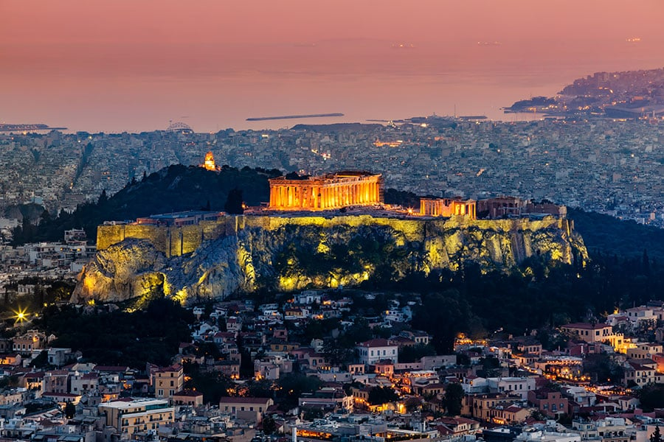
FINDING AN OPTIMAL PLACE FOR A CAFÉ SHOP IN ATHINA CITY, GREECE

Slide 3
Table of contents
Introduction: Business Problem
Data
Methodology
Analysis
Results and Discussion
Conclusion

Slide 4

Introduction: Business Problem
A close friend of mine asked me to help him with finding a good place for opening a cafe in Athina, Greece
It doesn't matter in which borough in Athina his cafe is going to open as soon as it is in the center of a borough with a lot of similar shops.

Slide 5
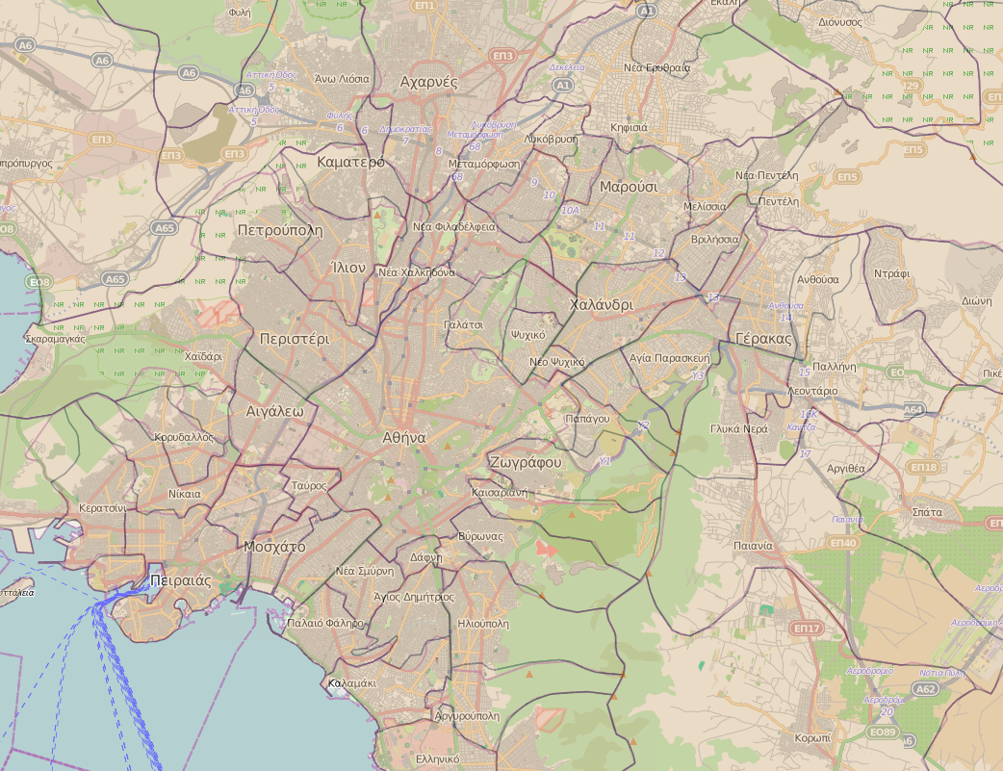

Data
http://geodata.gov.gr/
https://foursquare.com/

Slide 6
Methodology
104 Borough Centers (coordinates)
Information about shops around those centers (range <500m), according to Foursquare categorization
Cluster boroughs into five clusters
Choose the cluster that has a cafe shop as a first or second popular shop
Propose one of these boroughs as an optimal place to open a cafe

Slide 7
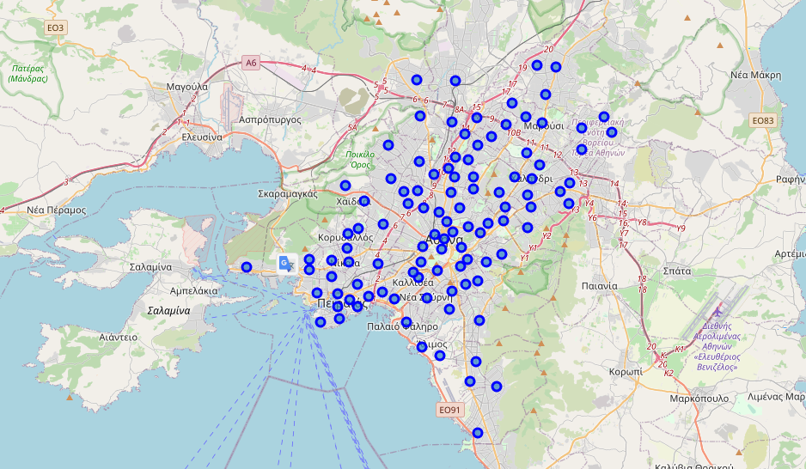
Analysis
Map of Athina with the 104 borough centers

Slide 8
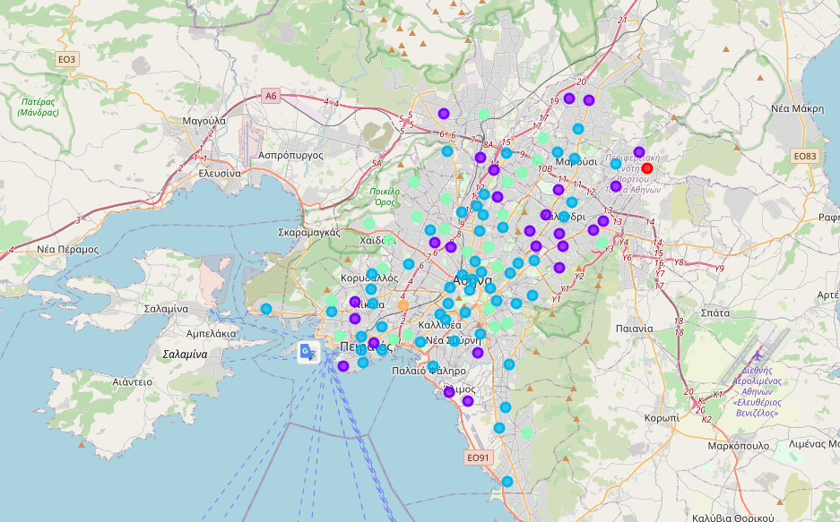
Analysis
Map of Athina with the 104 borough centers, into 5 clusters

Slide 9
Results and Discussion
Our analysis shows that cluster number 4 is the one with a high density of cafe shops, so these borough centers are candidates' places for our proposal.
We will take only those centers that have a cafe shop as the first common venue.
That choice narrows our results furthermore from 25 to 19 centers.
Lastly, if we want something closer to Athina center, we have only 6 centers.
We can propose any one of those 6 for opening a cafe shop.

Slide 10
Results and Discussion
Map of Athina with the optimal borough centers

Slide 11
Conclusion
The purpose of this project was to find for a friend of mine an optimal location for a business operation in Athina Greece, specifically a cafe shop.
As my friend request, it doesn't matter in which borough in Athina his cafe is going to open as soon as it is in the center of a borough with a lot of similar shops.
Our initial data includes 104 borough centers and after analysis, we cluster the centers into 5 clusters, we choose cluster number 4 as the most suitable and finally, we narrow down into 6 centers as optimal locations.
Of course, can be done more work and search these areas with more details.

Slide 12


